Slide 1
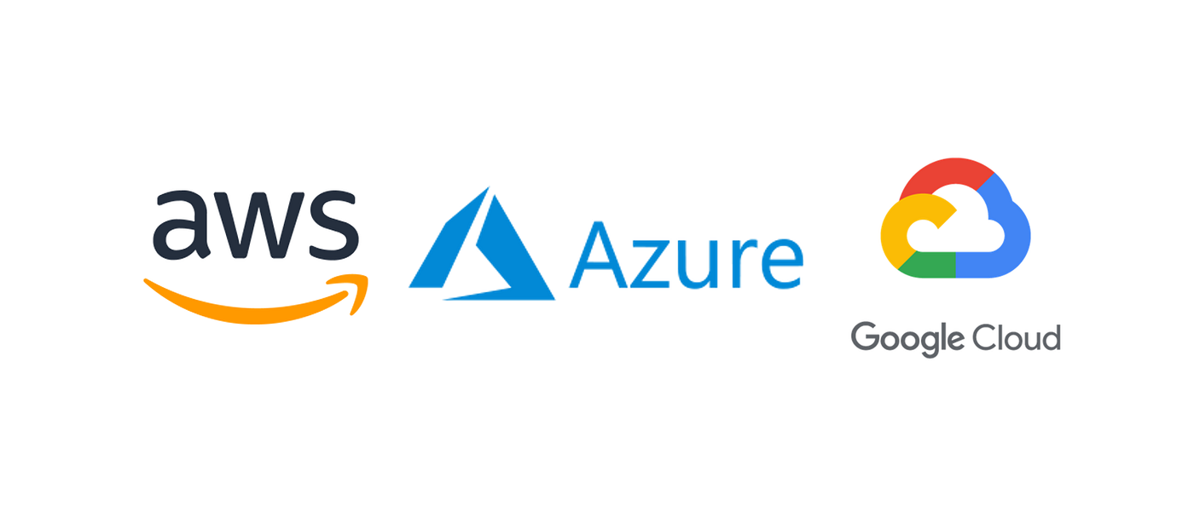
Cloud Databases: AWS, Google Cloud & Azure
Sunny Thakor : 240160510052
Hardik Mekhiya : 240160510027
Akshit Sonani : 240160510049

Slide 2
Introduction to Cloud Databases
What are Cloud Databases?
A cloud database is a database that runs on a cloud platform instead of on your own computer or servers. It lets you store, manage, and access data through the internet.
Examples: Amazon RDS, Google Cloud SQL, Azure SQL, MongoDB Atlas.
Why They Matter in Modern Applications?
Scalability – Apps like social media or e-commerce can support millions of users without slowing down.
Accessibility – Data is available from anywhere, which is useful for global teams and remote users.
Cost efficiency – Companies pay only for the storage and resources they use.
Reliability & Security – Cloud providers ensure backups, disaster recovery, and protection against data loss.
Speed of development – Developers can build apps faster without worrying about database setup.
Examples: Netflix uses cloud databases to recommend shows to millions of users.

Slide 3
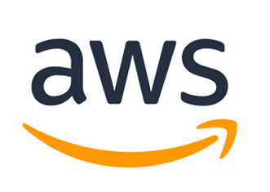
AWS Databases Overview
Amazon Web Services (AWS) offers many cloud database services to match different needs. Each one is designed for specific types of applications.
Amazon RDS (Relational Database Service)
A managed service for relational databases like MySQL, PostgreSQL, Oracle, and SQL Server.
AWS handles updates, backups, and scaling.
Good for apps that need traditional relational data storage (e.g., e-commerce, ERP).
Amazon DynamoDB (NoSQL)
A fully managed NoSQL database.
Stores data in key–value and document format.
Extremely fast and scalable, used in apps with millions of requests per second.
Example: Gaming, IoT, mobile apps, real-time chat apps.

Slide 4
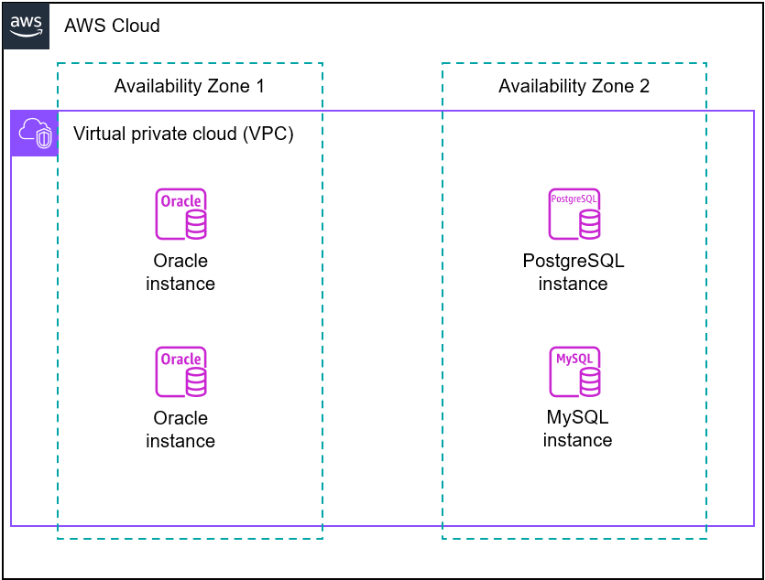
Aws - RDS (Relational Database)
Amazon Relational Database Service (Amazon RDS) is a web service that makes it easier to set up, operate, and scale a relational database in the AWS Cloud. It provides cost-efficient, resizable capacity for an industry-standard relational database and manages common database administration tasks.
Amazon RDS DB instances
VPC (Virtual Private Cloud): A private network inside AWS where the database instances run securely.
Availability Zone 1: Hosts two Oracle database instances for redundancy or load distribution.
Availability Zone 2: Hosts one PostgreSQL instance and one MySQL instance, giving flexibility to run different database engines.
Multi-AZ setup: By placing databases in different zones, the architecture ensures high availability and disaster recovery (if one AZ goes down, the other still works).

Slide 5
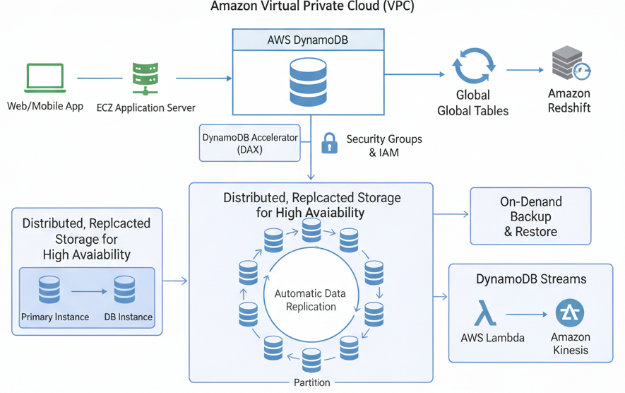
Aws - DynamoDB(Nosql)
Amazon DynamoDB is a fully managed NoSQL database service that provides fast and predictable performance at any scale.
It is serverless, automatically handling scaling, replication, and backups.
DynamoDB is ideal for applications needing low-latency access, such as gaming, IoT, and real-time analytics.
DynamoDB:
Data is stored in distributed, replicated storage across multiple partitions and Availability Zones for high availability.
Automatic data replication ensures fault.
On-demand backup & restore protects data.
DynamoDB Streams capture real-time data changes and can trigger AWS Lambda or feed into Amazon Kinesis.
Integration with Amazon Redshift for analytics.

Slide 6
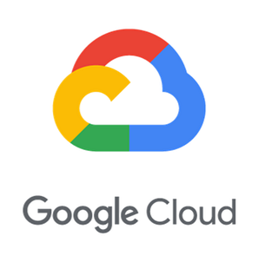
Google Cloud Databases Overview
All Google Cloud databases run on Google’s global infrastructure (data centers in multiple regions).
Databases are provided as managed services — no need to manage physical servers.
High availability through replication across zones/regions.
Relational Databases (SQL)
Cloud SQL
Managed relational DB service
Supports MySQL, PostgreSQL, SQL Server
Use case: traditional apps, ERP, finance
Cloud Spanner
Relational + globally distributed
Horizontal scaling + strong consistency
Use case: banking, retail, large-scale systems
Non-Relational Databases (NoSQL)
Firestore
Document-based NoSQL
Real-time sync (great for mobile/web apps)
Bigtable
Wide-column NoSQL
Petabyte-scale, high throughput
Use case: IoT, analytics, time-series data

Slide 7
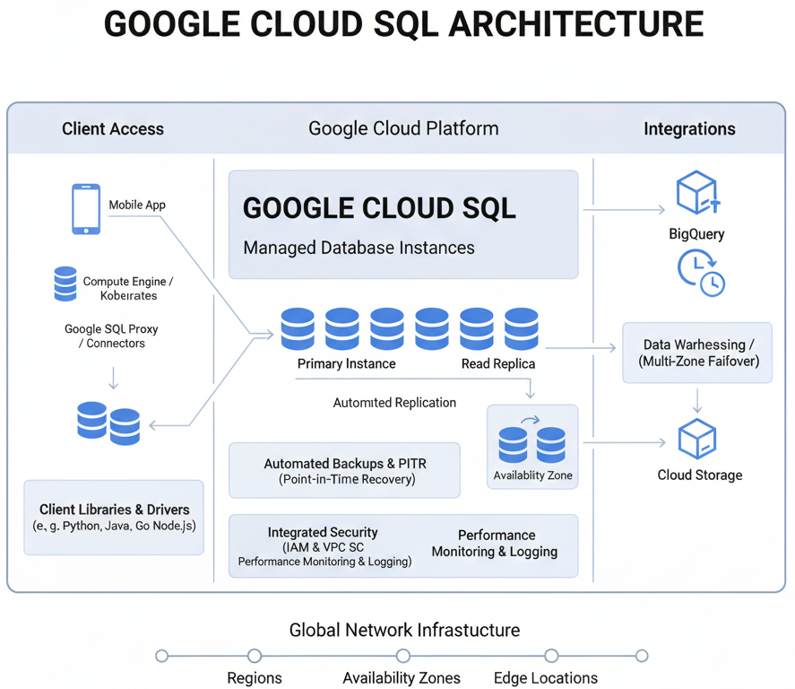
Google Cloud - Cloud SQL
Google Cloud SQL is a fully managed relational database service that supports MySQL, PostgreSQL, and SQL Server.
It handles backups, replication, updates, and failover automatically so you don’t need to manage servers.
It integrates with other Google Cloud services like BigQuery and Cloud Storage for analytics and data management.
Google Cloud SQL:
Provides managed database instances (MySQL, PostgreSQL, SQL Server).
Supports primary instance with read replicas for scaling reads.
Automated backups & point-in-time recovery.
High availability with multi-zone failover.
Integrations:
Works with BigQuery for analytics.
Triggers event/data pipelines.
Stores backups or exports in Cloud Storage

Slide 8
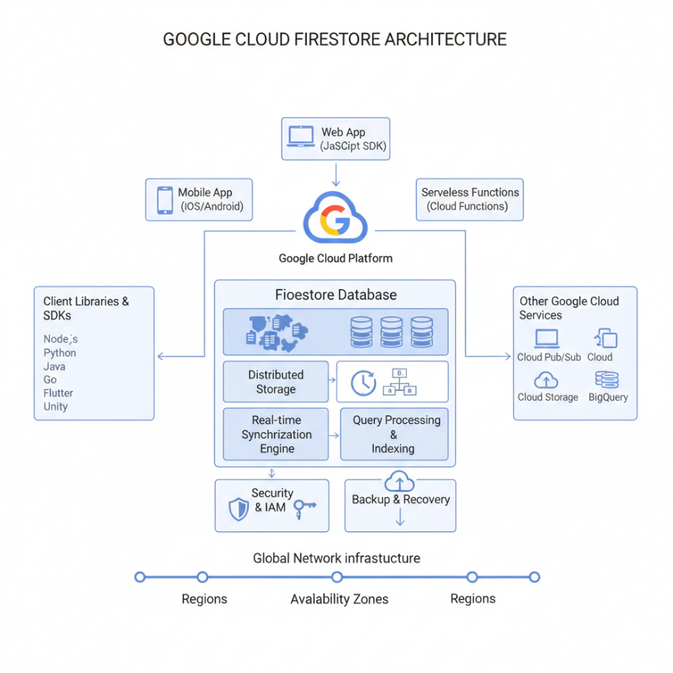
Google Cloud - Firestore
Google Cloud Firestore is a NoSQL document database for web and mobile apps.
It offers real-time synchronization and offline support, so data stays updated across devices instantly.
It’s scalable, serverless, and secure, with easy integration into Google Cloud services.
Firestore Database Core:
Distributed Storage stores documents and collections.
Real-time Synchronization Engine keeps data updated instantly across clients.
Query Processing & Indexing supports fast searches.
Security & IAM manages authentication and access.
Backup & Recovery ensures reliability.
Global Infrastructure: Data is replicated across regions and availability zones for performance and fault tolerance.

Slide 9
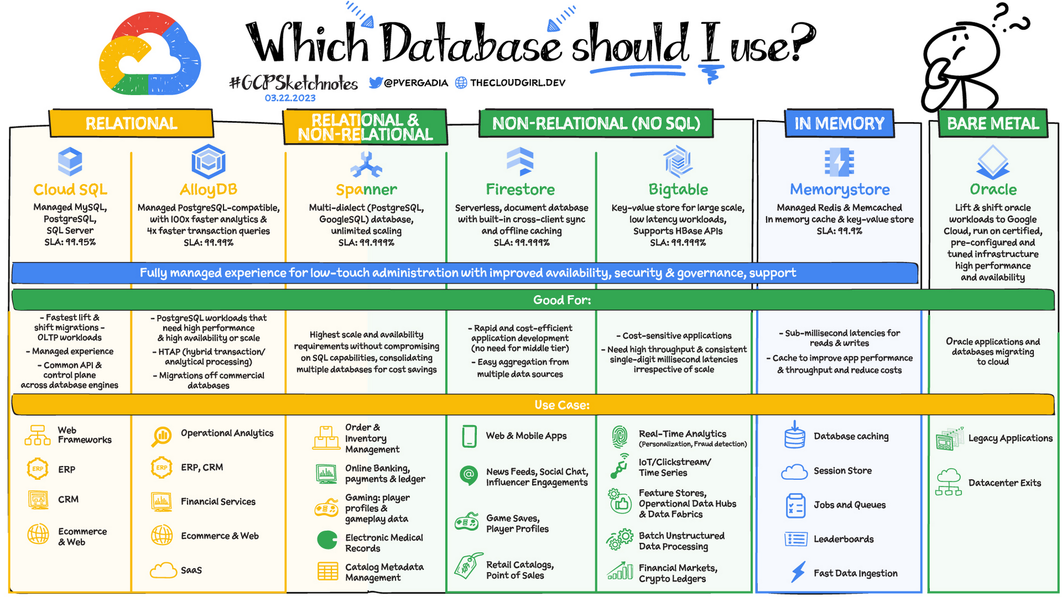

Slide 10
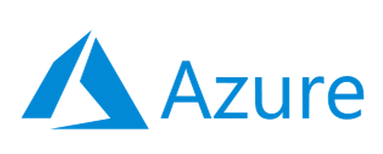
Azure Databases Overview
Microsoft Azure provides a range of managed database services for different application needs.
Azure SQL Database
Fully managed relational database based on Microsoft SQL Server.
Scales automatically and offers strong security.
Great for enterprise apps, finance, and business systems.
Azure Cosmos DB
Globally distributed NoSQL database.
Supports multiple data models: key–value, document, graph, and column.
Provides very fast performance worldwide.
Ideal for apps needing global reach, like social media or gaming.
Azure Database for PostgreSQL
Managed PostgreSQL service.
Handles open-source workloads with built-in high availability.
Commonly used for analytics, SaaS apps, and web backends.
Azure Database for MySQL
Managed MySQL service in the cloud.
Automatic scaling, backups, and patching.
Popular for content management systems (CMS) and e-commerce websites.

Slide 11
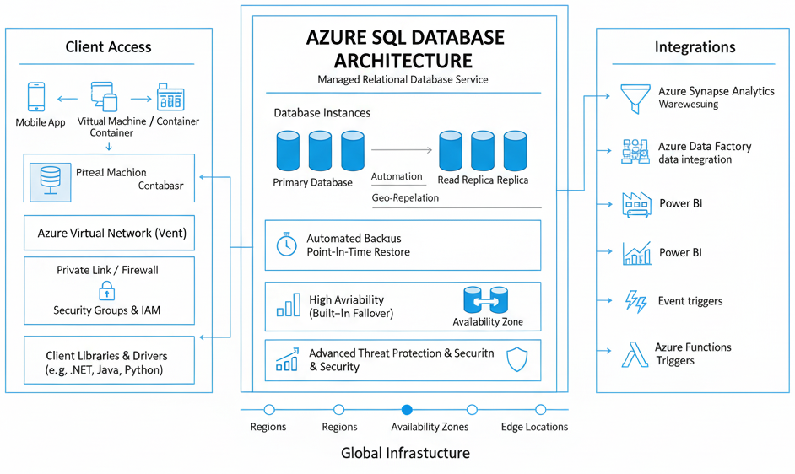
Azure - SQL Database
Azure SQL Database is a relational database (RDBMS) service provided by Microsoft Azure that is widely used by developers when creating new applications in the cloud. It is managed completely by Microsoft and is a highly scalable platform-as-a-service (PaaS) designed especially for cloud applications.
SQL Azure Architecture:
Database Instances Supports automated replication, read replication, and geo-replication.
Automated Backups → Point-in-time restore.
High Availability → Built-in failover for reliability.
Integrations:
Azure Synapse Analytics → Data warehousing.
Azure Data Factory → Data integration.
Power BI → Data visualization.
Event Triggers → React to database events.
Azure Functions → Trigger serverless workflows.

Slide 12
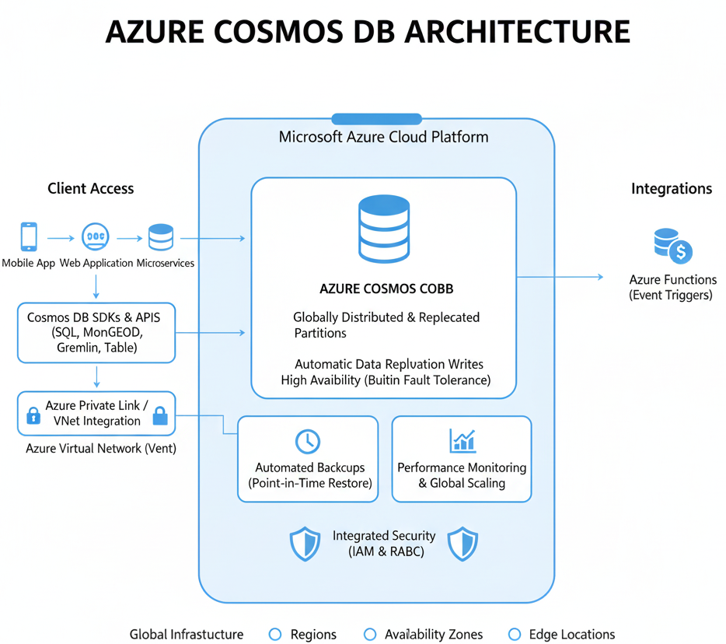
Azure - cosmos db
Azure Cosmos DB is a fully managed, globally distributed NoSQL database service by Microsoft.
It offers multi-model support (SQL, MongoDB, Gremlin, Table), automatic scaling, and low-latency access worldwide.
With built-in high availability, security, and replication, it’s ideal for modern, mission-critical applications.
Azure Cosmos DB
Globally Distributed & Replicated Partitions → Data automatically replicated across regions.
Automatic Data Replication Writes → Ensures fault tolerance and availability.
High Availability (Built-in Fault Tolerance) → Continuous availability across multiple regions.
Automated Backups (Point-in-Time Restore) → Data recovery at any point in time.
Performance Monitoring & Global Scaling → Monitors workloads and scales automatically worldwide.
Integrated Security (IAM & RBAC) → Access control with identity and role-based security.

Slide 13
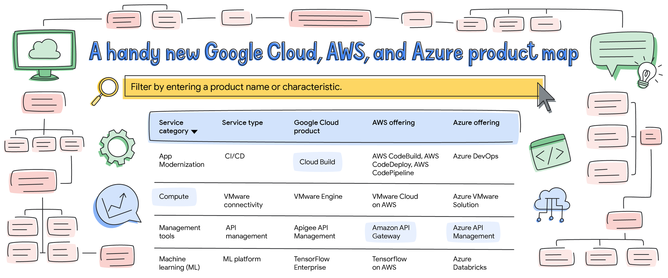

Slide 14
Thank you !

